Slide 1
The DNS Toolkit
All the fun one can have with DNS

Slide 2
IPv6
Private Hat Slide: Where is your IPv6!?☺
(Farsight is 2620:11c:f000::/44, AS393667)

Slide 3
Farsight Security, Inc.
https://www.farsightsecurity.com
Founded by Dr. Paul Vixie and Dr. Paul Mockapetris
Team based in US, Canada, Poland and Switzerland
Security defense and insight based on DNS
Projects:
SIE (Security Information Exchange)
DNSDB (DNS Database)
NOD (Newly Observed Domains)
Domain Sentry, Brand Sentry
and more…
This Talk:
RRL – Response Rate Limiting
DNS Query Collection (Logging, PassiveDNS, dnstap)
DNSDB – DNS Database
NOD – Newly Observed Domains

Slide 4
Spoof much?
Do you have MANRS?

Slide 5
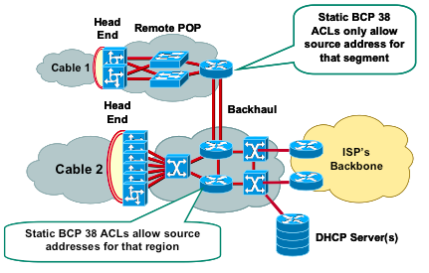
Anti-Spoof: Where are your MANRS?
Good old BCP38 (year 2000):
http://tools.ietf.org/html/bcp38
http://www.bcp38.info
MANRS
(Mutually Agreed Norms for Routing Security)
https://www.routingmanifesto.org/manrs/

Slide 6
RRL: Response Rate Limiting
Large DDoS attacks are common and big as amplification factor is large, as large number of open DNS recursors, large number of networks that allow spoofing (recent attacks with Mirai where btw not spoofed – do you NetFlow?)
NTP is not alone, SNMP and DNS…
RRL Limits the number of unique responses returned by a DNS server per e.g. IPv4 /24, or IPv6 /48
RRL makes informed decision, simple IP-based rate limiting would just randomly drop queries
Implemented in: NSD, BIND, Knot, more coming
Design & Implementation: Paul Vixie & Vernon Schryver
More details: http://www.redbarn.org/dns/ratelimits

Slide 7
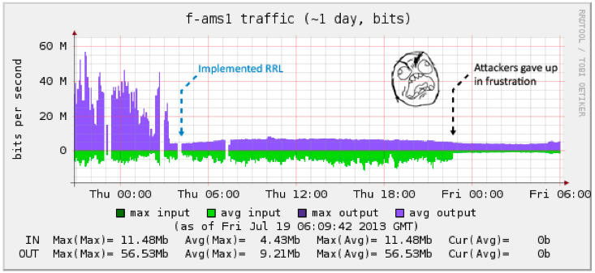
RRL: Example BIND & Knot
BIND
rate-limit {
responses-per-second 200;
window 2;
};
Knot
server:
rate-limit: 200
rate-limit-slip: 2

Slide 8
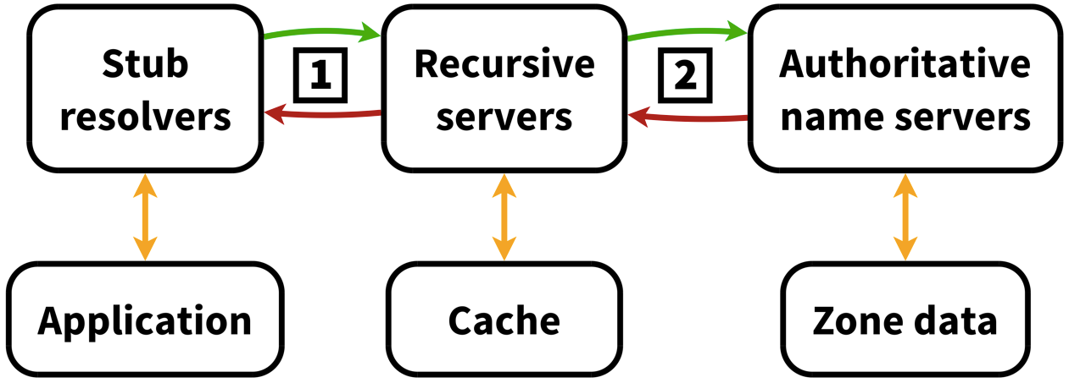
DNS Query Collection: Why?
Useful for determining what sites are visited/looked-up
Can indicate that a client in the network is connecting to a known C&C Botnet when using DNS – collect, analyze and know!
Above the recursor: does not collect PII as one does not see Stub’s IP address
1) below, 2) above – the recursor

Slide 9
DNS Query Collection: Query Logging
DNS Server logs queries to disk (file or syslog)
Slows DNS server itself down as syslog/file-writing is typically a blocking operation
Text-based, thus requires formatting/parsing and the overhead of ASCII
Lose all details not logged at that time (DNSSEC flags, cache miss/hit, etc)

Slide 10
DNS Query Collection: Passive DNS
Use a hub/mirror-port etc. to sniff the interface of the DNS server collection DNS responses
Full packet details, which need to be parsed
Requires TCP reassembly and UDP fragment reassembly
No performance impact on the actual DNS server
Can be done below and above the recursive

Slide 11
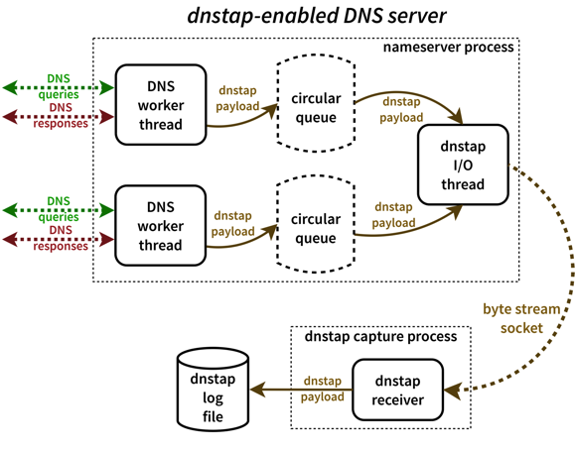
DNS Query Collection: dnstap
The best of Query Logging + Passive DNS: dnstap
Patch the DNS server to support logging using dnstap
Duplicates the internal parsed DNS format message
Uses circular queues & non-blocking logging techniques: minimal performance hit on DNS server
Implemented in BIND, Unbound, Knot DNS and more
Documentation / Tutorials / Mailinglist / Code: http://www.dnstap.info
Design & Implementation: Robert Edmonds

Slide 12
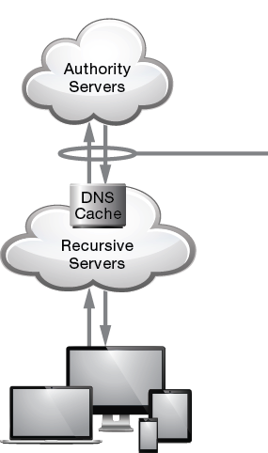
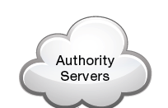
DNSDB: The DNS Database
Central repository from Passive DNS collectors data
Web-based query interface @ http://www.dnsdb.info
API (http://api.dnsdb.info) access for integration in various investigative tools
dnsdb-query (Python)
dnsdb_c (C ☺)
Maltego
Splunk
DNSDB Export: On-premise
Third-Party Threat Data
Security
Information
Exchange
Sensors
DNSDB
Real-Time Threat
Intelligence Information
Historical Threat
Intelligence Information

Slide 13
DNSDB Web Interface

Slide 14
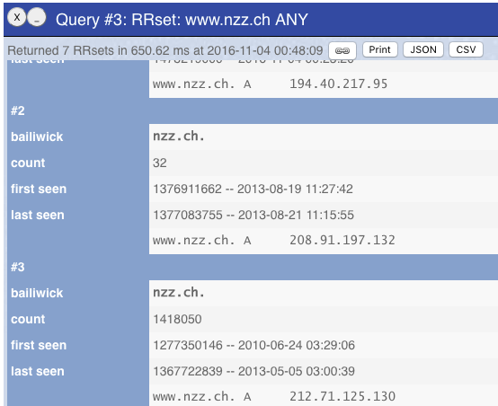

Slide 15
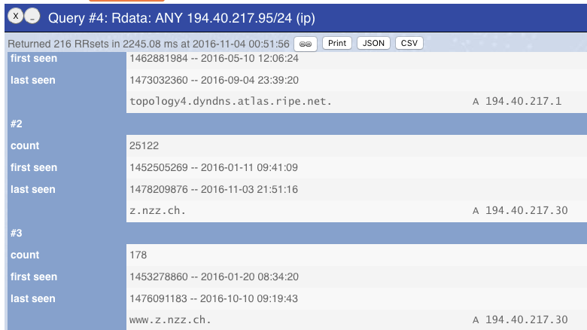

Slide 16
NOD: Newly Observed Domains
One can get ‘new’ domains from Zone File Access (ZFA) as provided by TLD operators (as per ICANN Base Registry Agreement)
But ZFA is not available for e.g. ccTLDs, .mil / .gov and badly managed ones
ZFA is only published every 24 hours
Might miss domains that are registered and removed inside that period again (eg domain tasting)
With the help of DNSDB, as it knows what is being queried:
If domain not seen for last 10 days: Newly Observed Domain!
NOD is published as RPZ zone, RBL zone or SIE channel 212
With RPZ: one can block or CNAME new domains to a safe place
Easily Integrate into SpamAssassin and other tools
Registration
Blocking
Propagation
Hosting
Payload Delivery

Slide 17
Questions!?
massar@fsi.io

Slide 18
RPZ: Response Policy Zones
Website with more details: http://www.dnsrpz.info
Also dubbed “DNS Firewalls”
Rules are carried in standard DNS zones
Using IXFR, NOTIFY, TSIG zone updates are distributed automatically and efficiently to stealth secondaries
Depending on rule, a different response might be returned than the real one

Slide 19
RPZ: Rule Types
Rules:
If the name being looked up is W.
If the response contains any IP address in range X.
If a listed name server name is Y.
If any returned name server IP address is in range Z.

Slide 20
RPZ: Actions
Synthesize NXDOMAIN.
www.infected.example.@ CNAME .
Synthesize NODATA:
www.infected.example.@ CNAME *.
Synthesize an answer.
www.infected.example.@ CNAME www.antivirus.example.
www.malificent.example.@ AAAA 2001:db8::42
Answer with the truth by not having an entry.

Slide 21
RPZ: Examples
BIND configuration options to enable 4 RPZ feeds:
response-policy { zone "rpz.deteque.com”;
zone “rpz.surbl.org”;
zone “rpz.spamhaus.org”;
zone “rpz.iidrpz.net”;
};
Note that RPZ servers are ACLd, hence need permission of operator to get access to the data

Slide 22
End of Deck™
That is it folks!

