Slide 1
Cybersecurity Coordination and Cooperation Colloquium (f41lf3st 2015)
17 June 2015
Tallinna Tehnickaülikool, Tallinn, Estonia
Tapping into a vat of DNS
Jeroen Massar, Farsight Security, Inc.
massar@fsi.io
IPv6 Golden Networks

Slide 2
Farsight Security, Inc.
http://www.farsightsecurity.com
CEO: Dr. Paul Vixie
Team based in US, Canada and Switzerland
Security defense and insight based on DNS
Major projects:
SIE (Security Information Exchange)
DNSDB (DNS Database)
NOD (Newly Observed Domains)

Slide 3
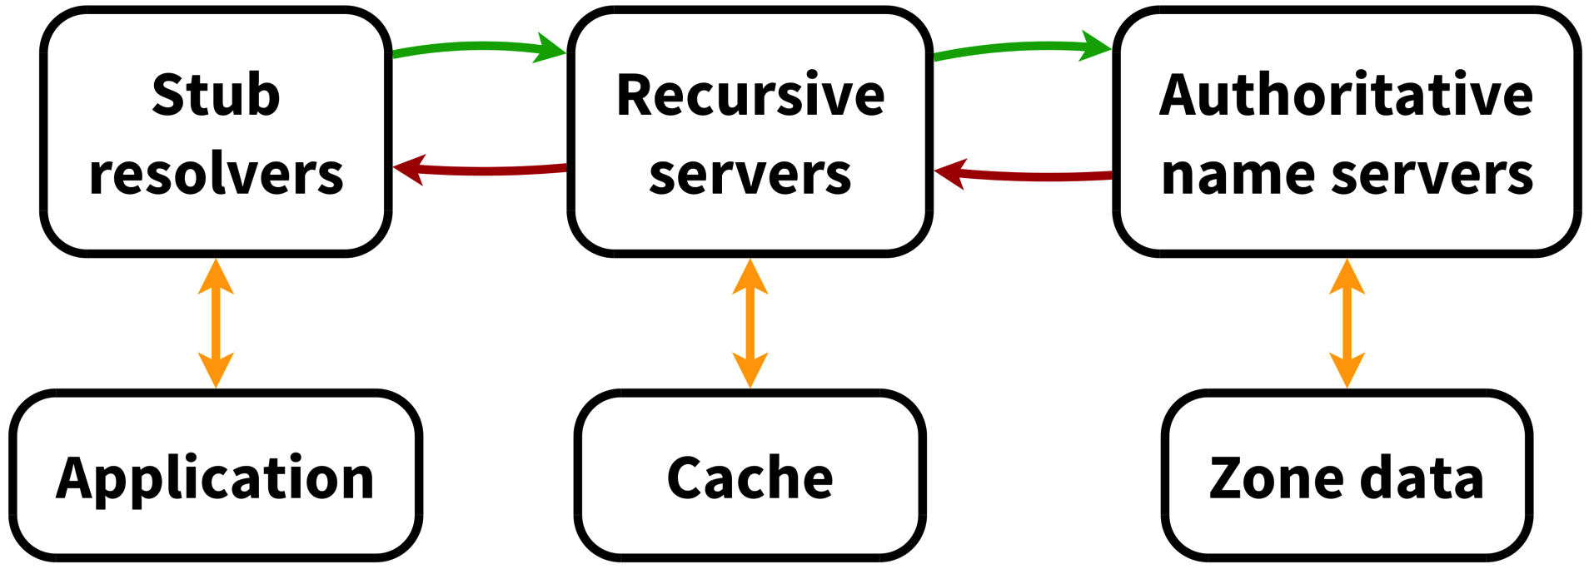
Simplified DNS Overview

Slide 4
Response Rate Limiting (RRL)
NTP DDoS attacks are common and big as amplification factor is large, large number of open recursors, large number of networks that allow spoofing
RRL Limits the number of unique responses returned by a DNS server per eg IPv4 /24, or IPv6 /48
RRL makes informed decision, simple IP-based rate limiting would just randomly drop queries
Implemented in: NSD, BIND, Knot, more coming
Credits: Paul Vixie & Vernon Schryver
More details: http://www.redbarn.org/dns/ratelimits

Slide 5
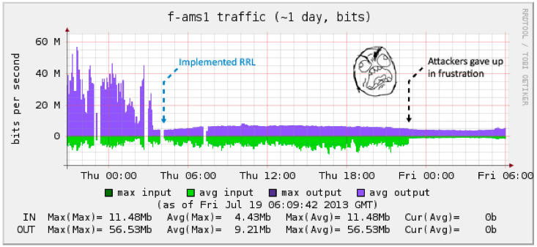
RRL Example
BIND Configuration in options section of configuration:
rate-limit {
responses-per-second 15;
window 5;
};
Graph courtesy of Peter Losher / ISC F-Root, when they enabled RRL on their Amsterdam node

Slide 6
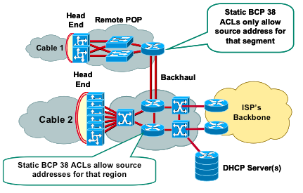
BCP38
http://tools.ietf.org/html/bcp38
http://www.bcp38.info

Slide 7
DNS Query collection
Useful for determining what sites are visited/looked-up
Can indicate that a client in the network is connecting to a known C&C Botnet when using DNS

Slide 8
Query Logging
DNS Server logs queries to disk (file or syslog)
Slows DNS server itself down as syslog/file-writing is typically a blocking operation
Text-based, thus requires formatting/parsing and the overhead of ASCII
Lose all details not logged

Slide 9
Passive DNS
Use a hub/mirror-port etc to sniff the interface of the DNS server collection DNS responses
Full packet details, which need to be parsed
Requires TCP reassembly and UDP fragment reassembly
No performance impact on the actual DNS server
Can be done below and above the recursive

Slide 10
dnstap
The best of Query Logging + Passive DNS: dnstap
Patch the DNS server to support logging using dnstap
Duplicates the internal parsed DNS format message
Uses circular queues & non-blocking logging techniques: minimal performance hit on DNS server
Implemented in Bind, Unbound, Knot DNS and more
Documentation / Tutorials / Mailinglist / Code:http://www.dnstap.info
Design & Implementation: Robert Edmonds

Slide 11
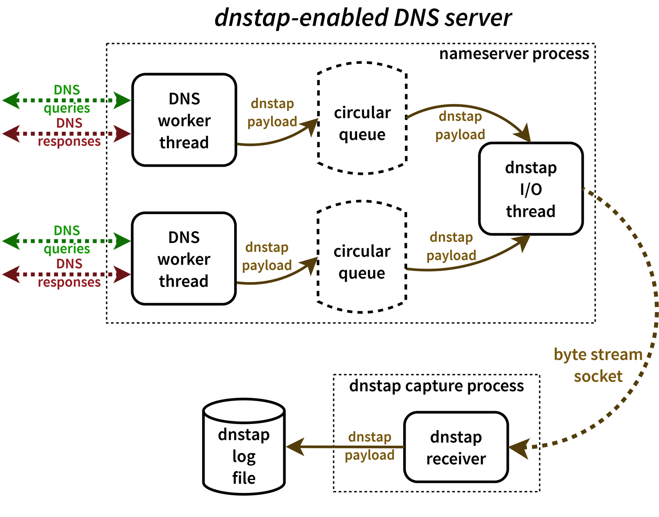
DNSTap Big Overview

Slide 12
Response Policy Zone (RPZ)
Website with more details: http://www.dnsrpz.info
Also dubbed “DNS Firewalls”
Rules are carried in standard DNS zones
Using IXFR, NOTIFY, TSIG zone updates are distributed automatically and efficiently to stealth secondaries
Depending on rule, a different response might be returned than the real one

Slide 13
RPZ: Rule Types
Rules:
If the name being looked up is W.
If the response contains any IP address in range X.
If a listed name server name is Y.
If any returned name server IP address is in range Z.

Slide 14
RPZ Actions
Synthesize NXDOMAIN.
www.infected.example.@ CNAME .
Synthesize NODATA:
www.infected.example.@ CNAME *.
Synthesize an answer.
www.infected.example.@ CNAME www.antivirus.example.
www.malificent.example.@ AAAA 2001:db8::42
Answer with the truth by not having an entry.

Slide 15
RPZ Examples
BIND configuration options to enable 4 RPZ feeds:
response-policy { zone "rpz.deteque.com”;
zone “rpz.surbl.org”;
zone “rpz.spamhaus.org”;
zone “rpz.iidrpz.net”;
};
Note that RPZ servers are ACLd, hence need permission of operator to get access to the data

Slide 16
DNS Database (DNSDB)
Central repository from Passive DNS collectors data
Web-based query interface
API access for integration in various investigative tools
http://www.dnsdb.info / http://api.dnsdb.info

Slide 17
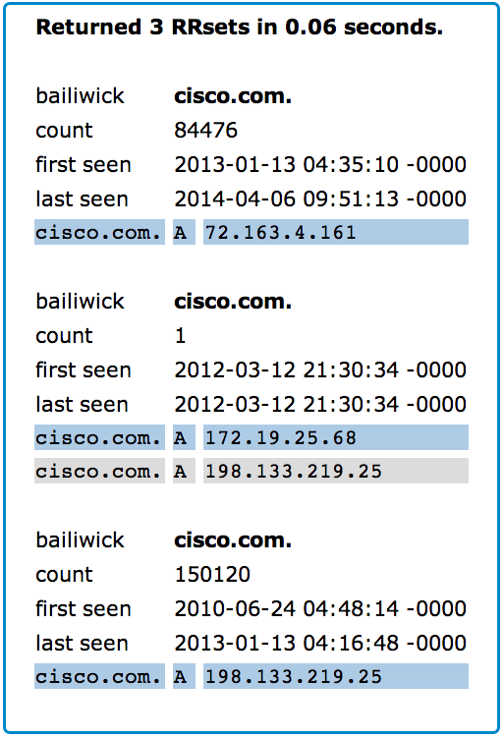

Slide 18
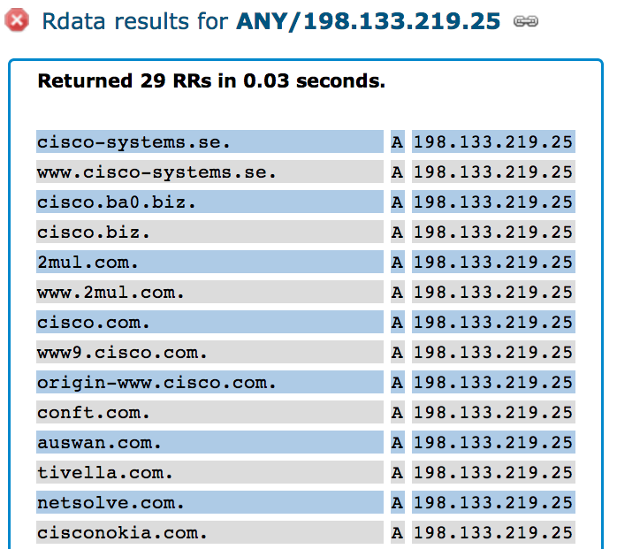

Slide 19
Newly Observed Domains
Zone File Access (ZFA) as provided by TLD operator (ICANN Base Registry Agreement)
ZFA is not available for eg ccTLDs, .mil etc
ZFA is only published every 24 hours
Might miss domains that are registered and removed inside that period again (eg domain tasting)
Hence: look at DNSDB, as it knows what is being queried. If domain not seen for last 10 days: Newly Observed Domain!
Newly Observed Domains (NOD) are published as RPZ zone

Slide 20
Malicious Domains Lifecycle
Registration
Blocking
Propagation
Hosting
Payload Delivery
Notes:
Domain names are cheap and plentiful.
Everything from DNS to web sites to email drop boxes. Using hacked sites for DoS get cleaned quickly as that gets noticed, thus their lifecycle is hours to days. Botnets are even worse. Rogue hosting providers are reliable but easy to spot.
- Widespread compromised websites.
- Storm botnet used Kademlia protocol for C2. Bots hosted web sites. Bots had terrible network connections and were effectively being DDoSed by traffic coming in. It was a wonder they ever made a sale.
- Bulletproof hosting in Russia via Russian Business Network. Solid hosting easily blocked.

Slide 21
Questions?
Jeroen Massar
massar@fsi.io
https://www.farsightsecurity.com

